Slide 1
Stock price analysis and prediction

Slide 2
Cooperation on a project: GitHub

Slide 3
Interesting agregations and sumations…

Slide 4
Matipulation of data with pandas

Slide 5
Some basic plotting

Slide 6
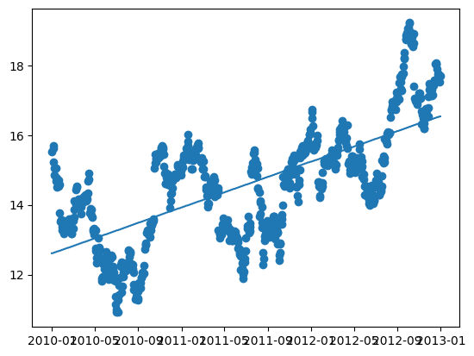
Linnear regression

Slide 7
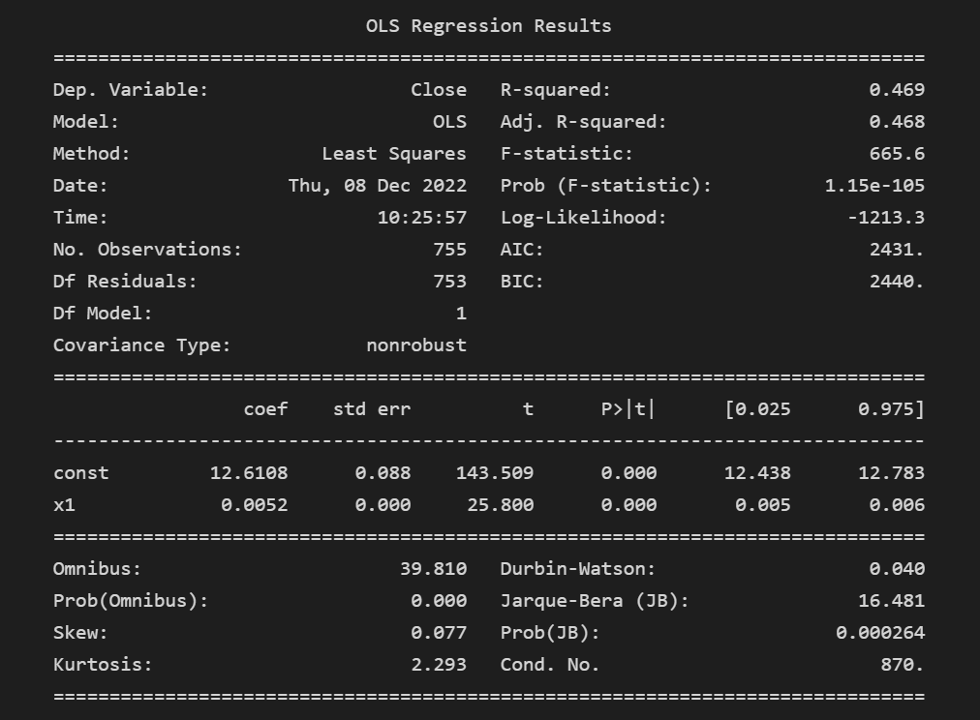
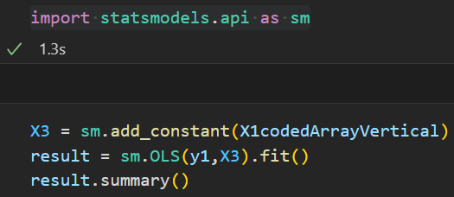
Linear regression

Slide 8
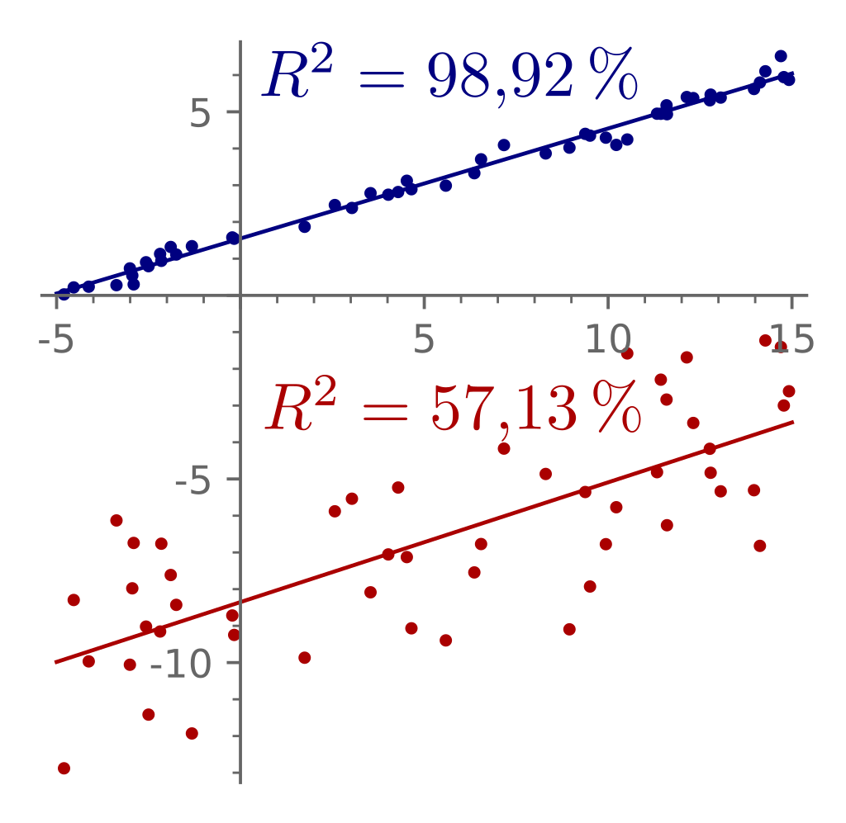

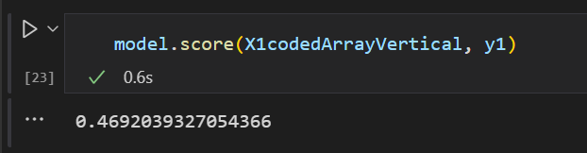
Problems with the model: R squared

Slide 9
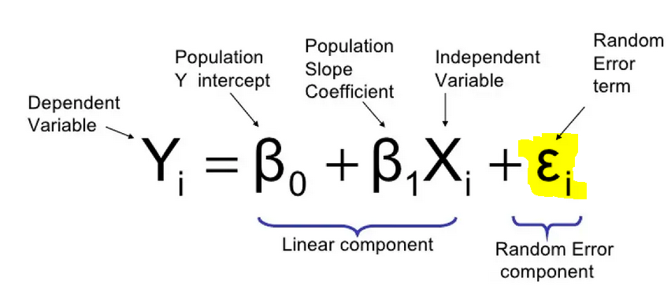
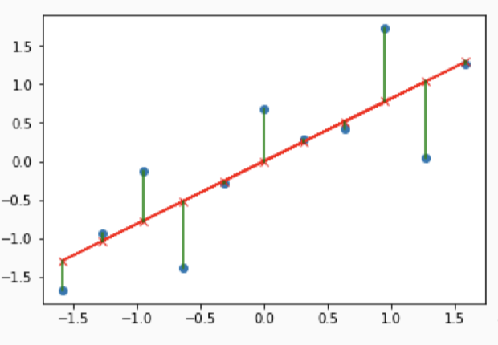
Residuals

Slide 10
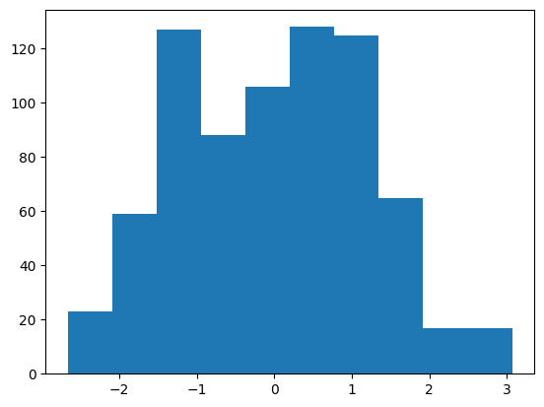
Problems with the model: residuals normally distributed?

Slide 11
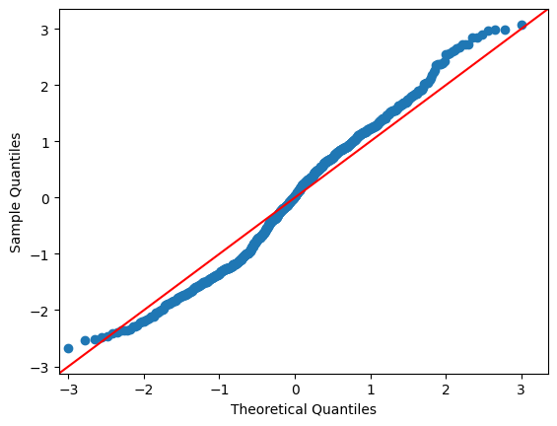
Problems with the model: residuals normally distributed?

Slide 12
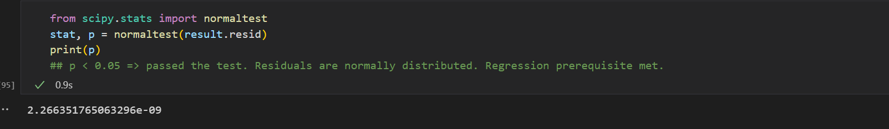
Problems with the model: residuals normally distributed?
p-value < 0.05 => passed the test. Residuals are normály distributed

Slide 13
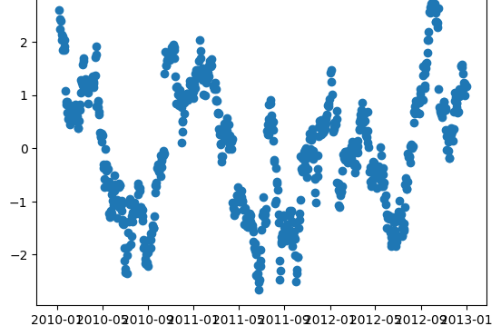
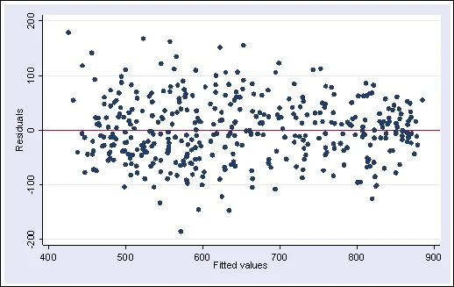
Problems with the model: Heteroskedasticity

Slide 14
Other types of regression?

Slide 15
Better model: Prophet

Slide 16
Q/A

